Slide 1

TensorFlow 2.0
PRACTICAL

Slide 2
PROJECT #1 OVERVIEW

Slide 3

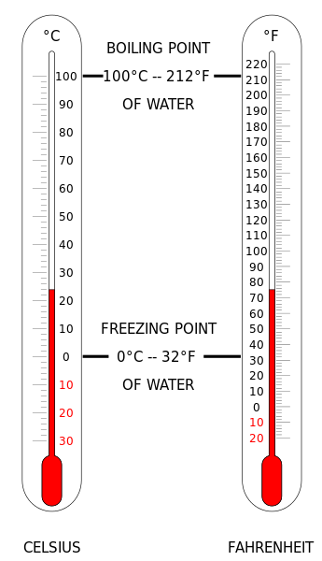
PROJECT #1: CONVERT °C TO °F
In this project, we will build a simple machine learning model to convert temperatures from Celsius to Fahrenheit.
The equation is as follows:
T(°F) = T(°C) × 9/5 + 32
For Example, let's convert 0°C celsius temperature to Fahrenheit:
T(°F) = (0°C × 9/5) + 32 = 32°F
Image Source: https://commons.wikimedia.org/wiki/File:Thermometer_CF.svg
TensorFlow 2.0 PRACTICAL

Slide 4
PROJECT #1: CONVERT °C TO °F
The objective is to predict the value of one variable Y based on another variable X.
X is called the independent variable and Y is called the dependant variable.
This is called “Regression” and it will be covered in much more detail in later sections of the course.
TEMPERATURE IN FAHRENHEIT (°F)
TEMPERATURE IN CELSIUS (°C)
TensorFlow 2.0 PRACTICAL

Slide 5
WHAT ARE ARTIFICIAL NEURAL NETWORKS AND HOW DO THEY LEARN?

Slide 6
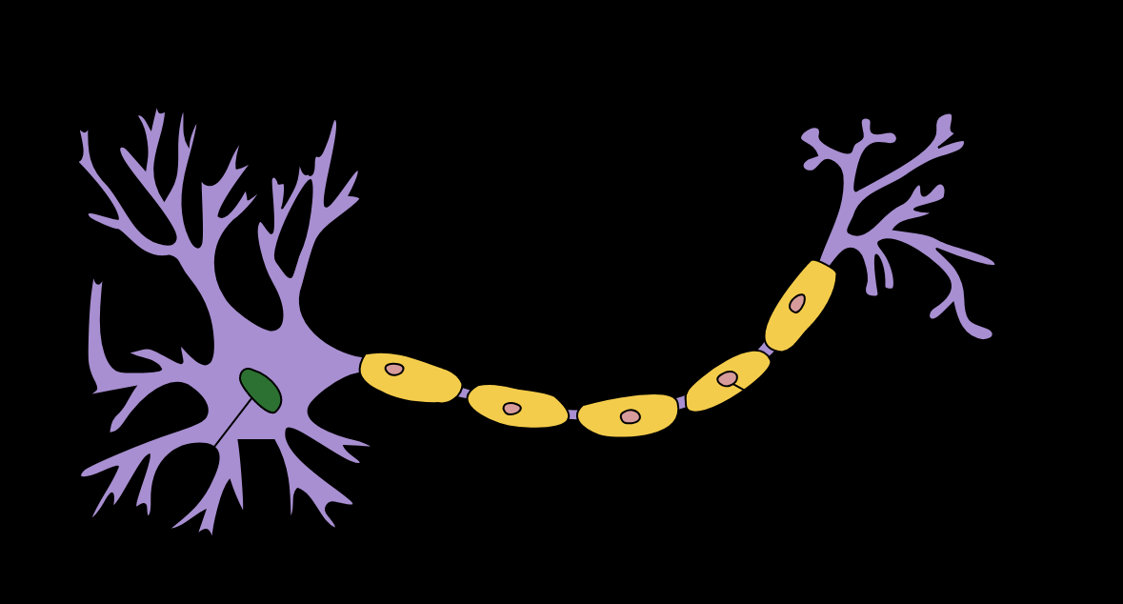
PROJECT #1: WHAT ARE ANNs AND HOW DO THEY LEARN?
The brain has over 100 billion neurons communicating through electrical and chemical signals.
Neurons communicate with each other and help us see, think, and generate ideas.
Human brain learns by creating connections among these neurons.
ANNs are information processing models inspired by the human brain.
TensorFlow 2.0 PRACTICAL

Slide 7
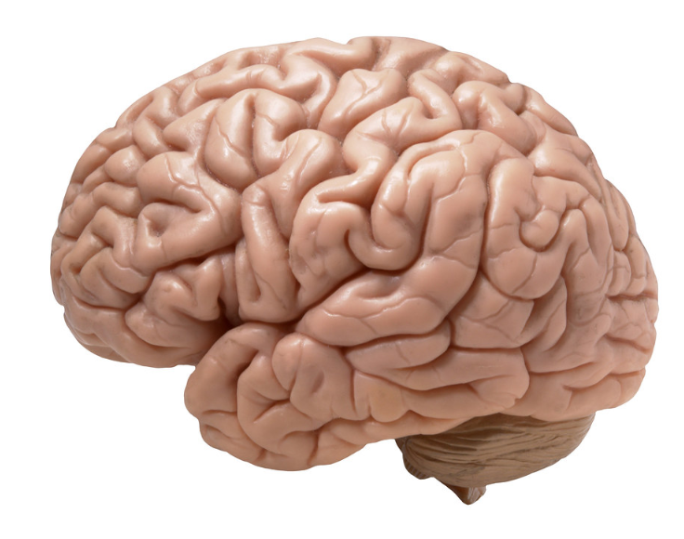
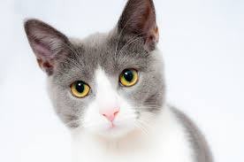
PROJECT #1: WHAT ARE ANNs AND HOW DO THEY LEARN?
Humans learn from experience (by example)
~Desired Outputs
LABEL: CAT!
Inputs
Deviated Outputs
Desired (Correct) Output
Update
Error
Photo Credit: https://www.flickr.com/photos/flamephoenix1991/8376271918
Photo Credit: https://www.pexels.com/photo/grey-and-white-short-fur-cat-104827/
TensorFlow 2.0 PRACTICAL

Slide 8
LET’S BUILD THE MOST SIMPLE NETWORK!
“A SINGLE NEURON MODEL”

Slide 9
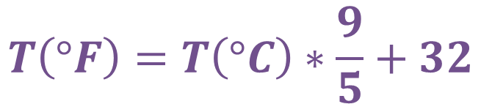


PROJECT #1: OUR FIRST NEURON MODEL
BIAS
$$Output=Input ∗W_{1}+Bias$$
DENDRITES
$$T\left(°F\right)=T\left(°C\right)∗W_{1}+Bias$$
$$T\left(°F\right)=T\left(°C\right)∗\frac{9}{5}+32$$
INPUT
NEURON
$$W_{1}$$
$$OUTPUT$$
AXON
NUCLEAS
TensorFlow 2.0 PRACTICAL

Slide 10
TENSORFLOW PLAYGROUND!

Slide 11
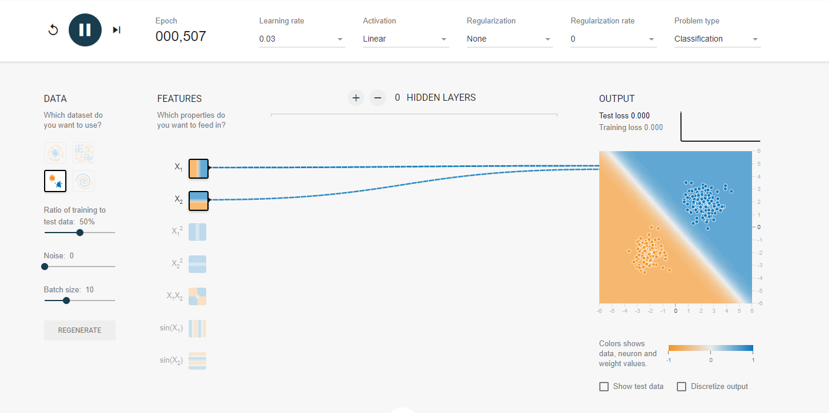
PROJECT #1: OUR FIRST NEURON MODEL
Check this out: https://playground.tensorflow.org
TensorFlow 2.0 PRACTICAL

